Slide 1
Multigroup Models
Byrne Chapter 7
Brown Chapter 7

Slide 2
Terms
Invariant – Equivalent
Means that the structures, items, etc. are equal

Slide 3
Questions
Do items act the same across groups?
Is the factor structure the same across groups?
Are the paths equal across groups?
Are the latent means equal across groups?
Does this replicate?

Slide 4
Quick Note
Most people only consider two groups at a time.
You can do more than two groups but it gets very complex

Slide 5
So how do we test this?
We start by working with the least restrictive model
This model is the base CFA you are working with.
You start by putting everyone together regardless of group (because if the regular CFA is bad, multigroup testing is not appropriate).

Slide 6
So how do we test this?
We start by working with the least restrictive model
Then you put them all together in one big model, separated by group but:
You let the estimates be different across groups

Slide 7
So how do we test this?
Then we move to more restrictive models
Force estimates to be equal across groups
Pick one estimate at a time, so you can see where the model breaks (or doesn’t)

Slide 8
Steps
Be sure to turn on estimate means and intercepts for these models because they are an important part of the steps

Slide 9
Steps
First, test the model as a regular CFA with everyone in the dataset
Do not group them
You must establish that the CFA is good first

Slide 10
Steps
Second, test each group separately
You will use the group function in the dataset window to pick one group at a time
Pick the variable that contains the grouping numbers (like the value label kind of thing in SPSS).

Slide 11
Steps
Second, test each group separately
Pick the one group, get the fit indices
Switch to the other group, get the fit indices
Fit?
If the fit for one group is extremely different (or bad), you would stop here. You need them to be roughly equal.

Slide 12
Steps
Nesting!
The next steps will be to nest the two models together.
Nesting is like stacking the models together (like pancakes).

Slide 13
Steps
For the nested model steps, most people use Brown’s terminology and procedure.
Byrne’s is a mix of the two – and not the way you see them published in journals.

Slide 14
Steps
All the possible paths:
The whole model (the picture)
Loadings (regression weights)
Intercepts (y-intercept for each item)
Error variances (variance)
Factor variances (variances for the latents)
Factor covariances (correlation)
Factor means (latent means)

Slide 15
Steps
Y = a + bx + e
A = intercept
B = Loading
E = residual

Slide 16
Steps
Equal form / configural invariance
In this model, you put the two groups together into the same model.
You do not force any of the paths to be the same, but you are forcing the model picture to be the same.
You are testing if both groups show the same factor structure (configuration).

Slide 17
Steps
Metric Invariance
In this model, you are forcing all the factor loadings (regression weights) to be exactly the same
This step will tell you if the groups have the same weights for each question – or if some questions have different signs or strengths

Slide 18
Steps
Scalar Invariance
In this model, you are forcing the intercepts of the items to be the same.
This step will tell you if items have the same starting point – remember that the y-intercept is the mean of the item.
If a MG model is going to indicate non-invariance – this step is usually the one that breaks.

Slide 19
Steps
Strict Factorial Invariance
In this model, you are forcing the error variances for each item to be the same.
This step will tell you if the variance (the spread) of the item is the same for each item. If you get differences, that indicates one group has a larger range of answers than another. (means they are more heterogeneous).

Slide 20
Steps
Population Heterogeneity
Equal factor variances
Testing if latents have the same set of variance – means that the overall score has the same spread
Equal factor covariances
Testing if the correlations between factors is the same for each group
Equal latent means
Testing if the overall latent means are equal for each group

Slide 22
How to tell?
How can I tell if steps are invariant?
You will expect fit to get worse as you go because you are being more and more restrictive.
You can use a change in chi-square test (not suggested too much because of chi-square issues we’ve discussed before).
Most people use the change in CFI test.

Slide 23
What next?
What do I do if steps are NOT invariant?
Partial invariance – when strict invariance cannot be met, you can test for partial invariance

Slide 24
Partial Invariance
Partial invariance occurs when most of the items are invariant but a couple.
You have to meet the invariance criteria, so you trying to bring your bad step “up” to the invariant level
You want to do as few of items as possible (see table in handout).

Slide 25
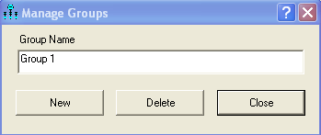
Manage Groups Window
To add groups, double click on the group 1 label, hit add.
You will have to add the second group’s data and value labels

Slide 26
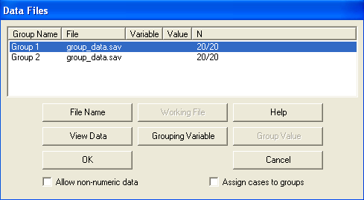

Slide 27
Multigroup Window
Click manage > multigroup analysis
You’ll get a message that says it will delete models, just say ok!
You’ll get a bunch of check marks – you will need to change them to match the steps we use.

Slide 28
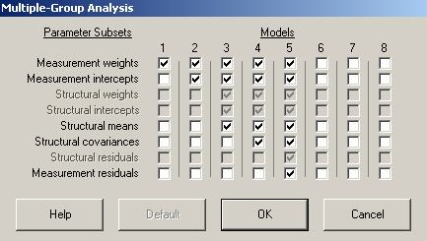
Weights = loadings, intercepts = intercepts, take off means and covariances, leave residuals

Slide 29
Manage Models
You will get a bunch of new models in the models section
I highly recommend relabeling these to match our steps, so the output makes sense.

Slide 30
Steps
In the group window
Equal form: will be blank
Metric Invariance: a values
Scalar Invariance: I values
Strict factorial invariance: v values

Slide 31
Steps
Population Heterogeneity
Equal factor variances: vvv values
Equal factor covariances: ccc values
Equal latent means: you will have to give these text values, as they are automatically set to zero.
We will go over this Wednesday!

Slide 32
Partial Invariance
So, how do I test partial invariance?
You will change ONE item at a time.
What you’ve done in the group window is set them to equal (name of path _ model number).
If you take that line OUT, then you’ve let them be unequal.
You want to take it out, then put it back. Change ONE at a time.

Slide 33
Let’s Try It!
10 MG RS 14.sav

Slide 34
Latent Means in AMOS
The previous steps examined if the equation for each person was invariant. Next, we can examine the higher order structure to determine if they are invariant

Slide 35
Latent Means in AMOS
On an already programmed model – we are going to add the latent means.
First, you have to set them to something other than zero.
Double click to get object properties.
Change the mean from 0 to a label (text).

Slide 36
Latent Means in AMOS
Now we are going to add in that latent mean restriction to our final model from the traditional invariance steps
So that might be a partially invariant model

Slide 37
Latent Means in AMOS
Double click on a model in manage models
Add a new model
Set the means to equal using the names you just created
Remember (label _ group number)

Slide 38
Latent Means in AMOS
You want to use the same procedure, check and see if there a significant degrade in fit when you set them to equal.

Slide 39
Factor Means by hand
A more common approach is to calculate the weighted means by hand (excel!).
You will take the estimates for the loadings for each factor
So, if you have two factors you will need the weights for each one but separately, aka don’t just all them all together.

Slide 40
Factor Means by hand
You will calculate the factor score for each person by multiplying their individual item score times the loading
Then you can average them or total them depending on how the scale is traditionally scored

Slide 41
Factor Means by hand
Think about this for a second:
We normally use EFA/CFA to show that each question has a nice loading and the questions “go together”
And then we totally ignore the fact that the loadings are different and just create total scores or average scores.
Why lose that information?

Slide 42
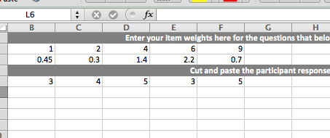
Factor Means by hand

Slide 43
Factor Means by hand
Then you can test if groups are different by using either excel or SPSS on the factor means.

Slide 44
Let’s Try It!
Using the RS14 data from yesterday.

